Slide 1

R Package Development and Validation
Concepts of
R Package Validation

Slide 2
Welcome
Validation
R Packages
R Package Validation Framework
Q&A
Notes:
Validation
What is it
Why do we do it
Benefits not immediately obvious
How Validation is related to R packages
Why are we even talking about Validation in the context of R packages
R Package Validation Framework
What is it
How it helps
Concepts to know and learn
General applicability
Q&A

Slide 3
Validation

Slide 4
General Principles of Software Validation; Final Guidance for Industry and FDA Staff
FDA considers software validation to be “confirmation by examination and provision of objective evidence that software specifications conform to user needs and intended uses, and that the particular requirements implemented through software can be consistently fulfilled.”
Notes:
What does the FDA say?

Slide 5
General Principles of Software Validation; Final Guidance for Industry and FDA Staff
FDA considers software validation to be “confirmation by examination and provision of objective evidence that software specifications conform to user needs and intended uses, and that the particular requirements implemented through software can be consistently fulfilled.”
Notes:
Confirmation by examination
Review and approval of all aspects of the software
Testing
objective evidence
Documentation
Proof
Not subject to opinion or

Slide 6
General Principles of Software Validation; Final Guidance for Industry and FDA Staff
FDA considers software validation to be “confirmation by examination and provision of objective evidence that software specifications conform to user needs and intended uses, and that the particular requirements implemented through software can be consistently fulfilled.”
Notes:
Specifications are a document that states requirements
So proof that SME’s, users, managers, etc
Given the scope of the software
have reviewed the specs
Agree that it meet their needs for a particular task
“objective evidence” – official sign off

Slide 7
General Principles of Software Validation; Final Guidance for Industry and FDA Staff
FDA considers software validation to be “confirmation by examination and provision of objective evidence that software specifications conform to user needs and intended uses, and that the particular requirements implemented through software can be consistently fulfilled.”
Notes:
The software can meet the requirements from the specs
So proof from software that
Every requirement has been met
Every requirement can consistently be met
So…testing and documenting the results.

Slide 8
Create documentation that the users needs are satisfied by the requirements, and record results from testing that that each requirement has been met by the software
Notes:
In layman's terms

Slide 9
Create documentation that the stakeholder needs are satisfied by the requirements, and record results from testing that that each requirement has been met by the software
Notes:
In layman's terms

Slide 10
Why bother validating
Requirements by government or industry authorities
FDA (Pharma)
Understanding of the process and goals of stakeholders
Trust in your thoroughly vetted software returning correct results
Speed in processing because details have been abstracted
Reduced cost of maintenance
Notes:
Why do we even care, why is this in our lexicon as programmers to worry about proving our code works?
Requirements by authorities (governmental or industry)
Most commonly cited (including Wikipedia) is the FDA, who have released guidances
Military software, such as software controlling missiles undergoes a rigorous Independent software verification and validation
FAA (planes)
NASA and European Space Agency
Benefits outside the “requirements”
Opportunity for leadership stakeholders and user stake holders to come together and come to consensus
Through testing outside of standard unit or regression testing leading to confidence
Improved documentation to help new users
Software abstracts some steps/difficult pieces away resulting in speed improvements in implementation and optimal code for run speed
Thorough testing leads to less bugs, less maintenance, and identifying breaking changes earlier

Slide 11
Risk-Based Valdation
Not everything needs to be validated
Risk based – which should be validated
Word processing software
Software processing and developing response calls of assay data

Slide 12
R Packages
Notes:
This is a workshop on R package validation, what do R packages and validation have in common?
R packages are software

Slide 13
R package and validation
Benefits of R packages
Shared code
Centralize management
Documentation for sharing knowledge
Working in a regulated industry means code could be used as part of a project where validation measures need to apply
Notes:
Benefits of R packages are commonly stated – many pages of digital ink have been poured over
Working in a regulatory industry, an internal R package may work its way into a project that gets additional scrutiny, so making sure to take a risk based approach to package validation

Slide 14
R Package Validation FRamework
Notes:
This is a workshop on R package validation, what do R packages and validation have in common?
R packages are software

Slide 15
Validation can be a high bar
Fill out a form for specifications, planned uses, environments
Write Code and record function authorship in some excel file
Get another form to document test cases, testing environment, ...
Maybe the last form to show that testing plan is comprehensive
Manually evaluate tests and screenshot results
Review documentation, combine into final report and signoffs for release

Slide 16
R Package Validation Framework
Validation Report
R Package Development
Test Cases
Test Code
Requirements
Record the expectations, goals, and risks of project
Implementation of requirements into R package
Describes how code meets specifications
Implementation of the test cases in code
Combines all prior content into report documenting proof that code meets specifications

Slide 17
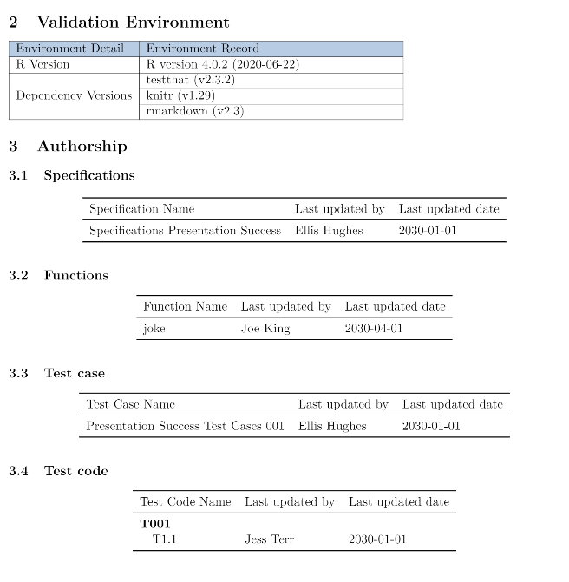
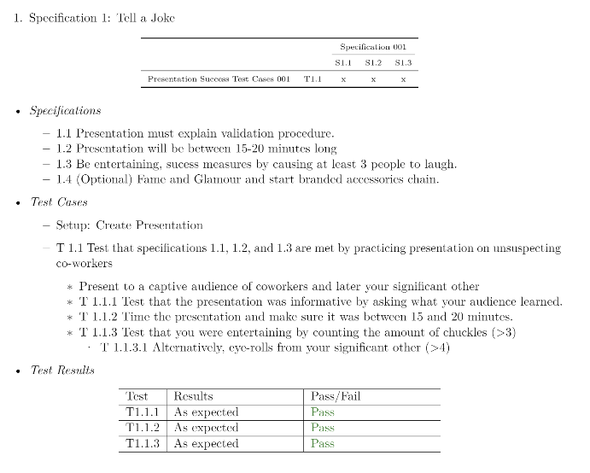
Validation Report
Notes:
Open source tools can be extended (R packages)
- _ANYONE_ can build an R package
- change and build to address the needs of the users
- companies and teams can build packages to create a unified approach to similar problems
- benefits of R packages
Not all R packages are made equal
Maintainer
Documentation
Testing

Slide 18

“
The framework turns validation into a transparent, easy-to-follow process that not only that simplifies validation but improves the quality of both the package and validation.
- Me
Notes:
Framework aims to solve difficulties around validation by creating a clear process to follow. Each step builds on the next in a logical pattern, and stays close to the package. We meet the development team where they are at.

Slide 19
PHUSE Working Group
White Paper
Distillation of framework
Collaboration
R Package
Implementation of framework
Inspired by {devtools} and {usethis}
remotes::install_github(“phuse-org/valtools”)

Slide 20
Requirements
Record the expectations, goals, and risks of project
R Package Development
Implementation of requirements into R package
Test Cases
Test Code
Implementation of the test cases in code
Validation Report
Describes how code meets specifications
Combines all prior content into report documenting proof that code meets specifications

Slide 21

Requirements
Goals and Purpose
Risk assessment
Probability of defects
Impact when there are defects
Provides all context required or points to references
Stakeholder approval of each requirement

Slide 22

Documenting Requirements
Human and machine readable
Capture editor and edit date
Record and save within the validation folder
Working_dir/validation/requirements

Slide 23
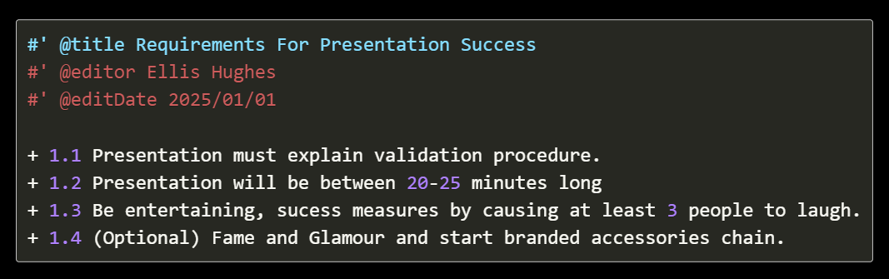

Slide 24
Validation Report
R Package Development
Test Cases
Test Code
Requirements
Record the expectations, goals, and risks of project
Implementation of requirements into R package
Describes how code meets specifications
Implementation of the test cases in code
Combines all prior content into report documenting proof that code meets specifications

Slide 25
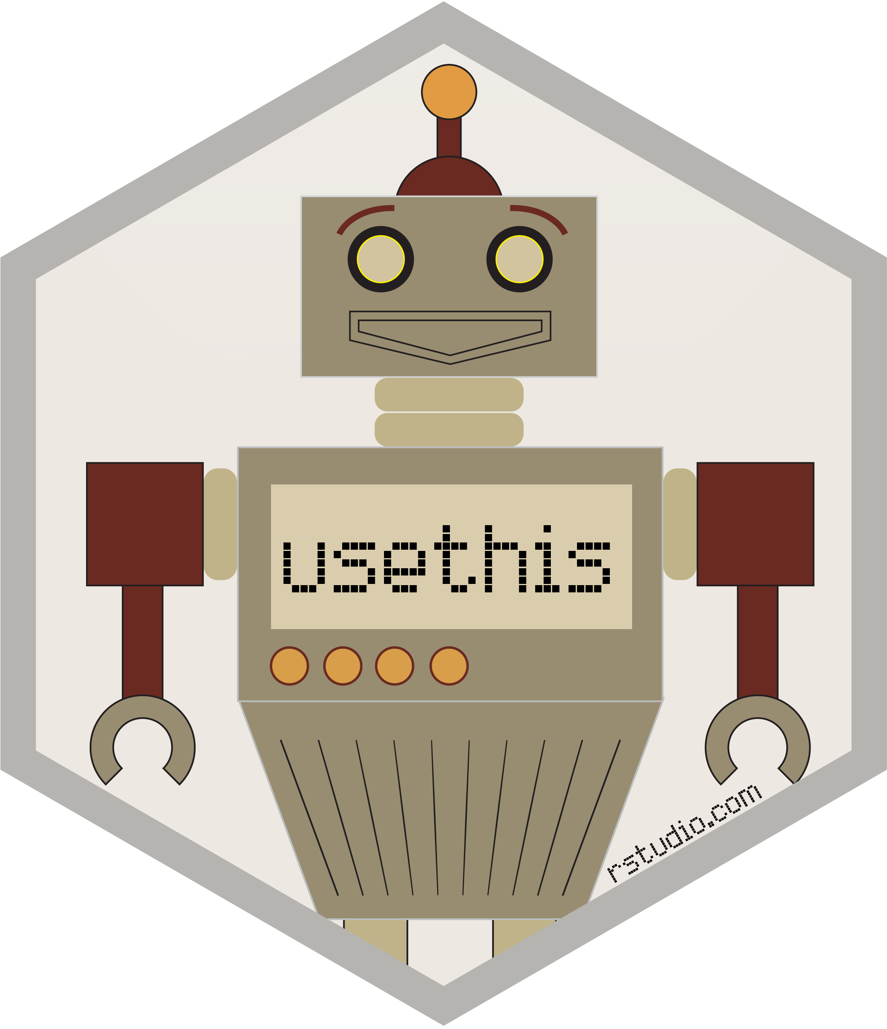

Package Development
Follow GPP
Documentation
Function manuals
Vignettes
What we talked about in the earlier sessions

Slide 26
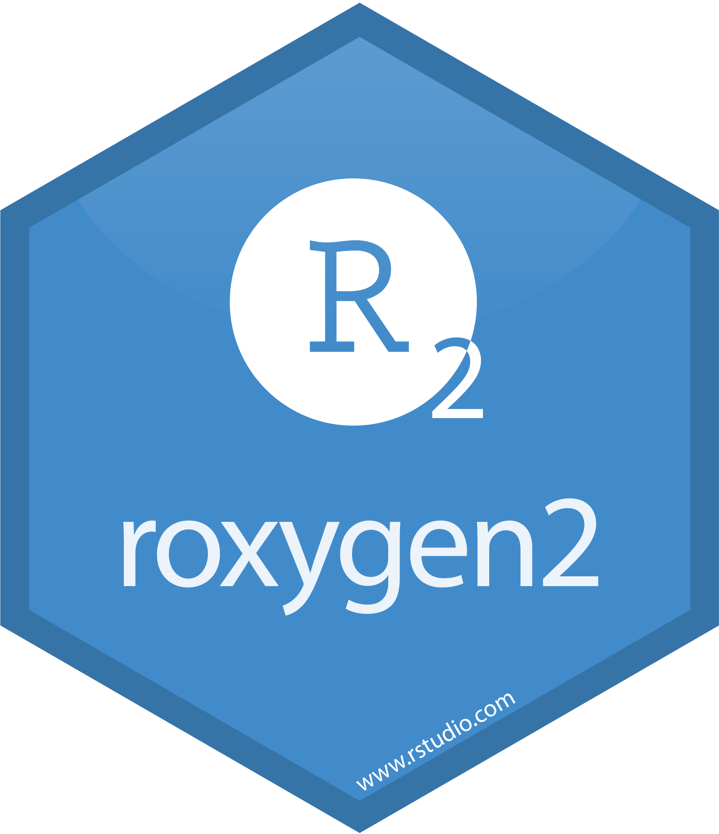
Function documentation
Record with function using Roxygen
Easier to remember
Adds to documentation
@editor
@editDate

Slide 27
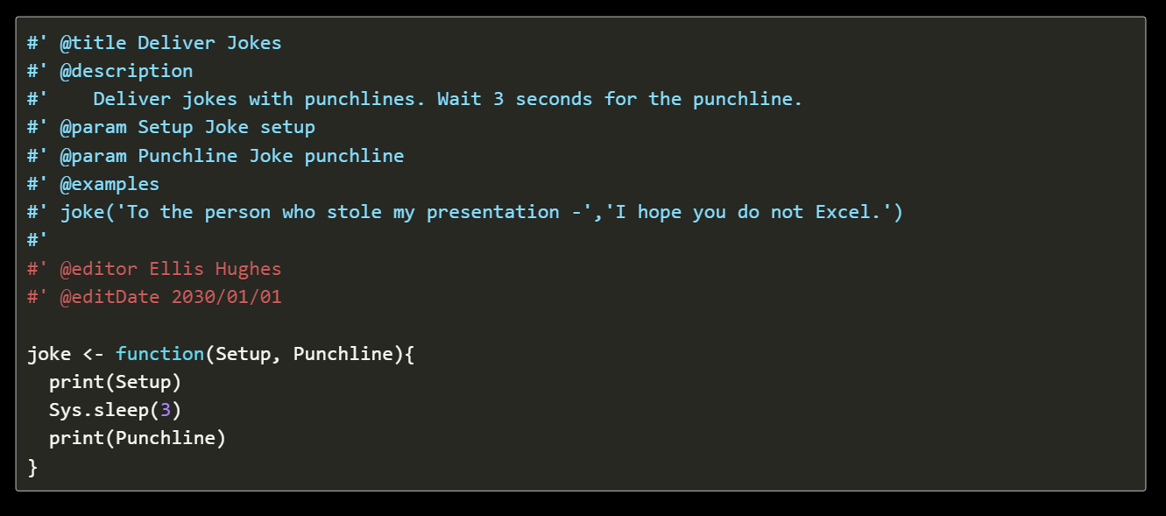

Slide 28
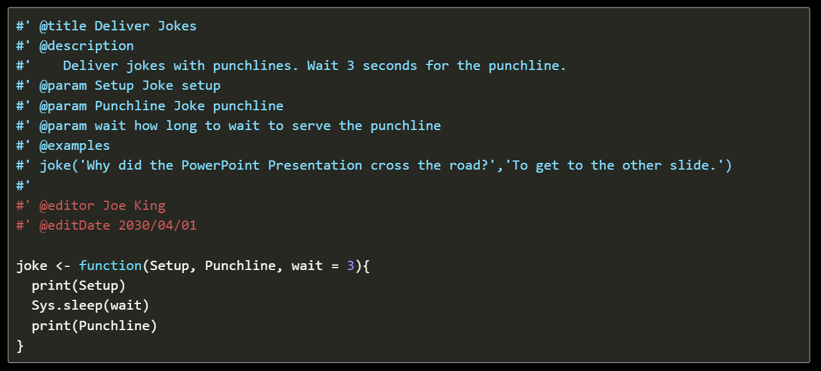

Slide 29
Validation Report
R Package Development
Test Cases
Test Code
Requirements
Record the expectations, goals, and risks of project
Implementation of requirements into R package
Describes how code meets specifications
Implementation of the test cases in code
Combines all prior content into report documenting proof that code meets specifications

Slide 30
Test Cases
Document how to prove package meets specifications
Should represent realistic scenarios
Every requirement must be satisfied by at least one test case
A test case can satisfy multiple requirements
Requirement | Test Case
Requirement 1 | Test Case 1, Test Case 2
Requirement 2 | Test Case 2, Test Case 3
Requirement 3 | Test Case 3

Slide 31


Documenting Test Cases
Human and machine readable
Capture editor, edit date, coverage
Record and save within the validation folder
working_dir/validation/test_cases

Slide 32
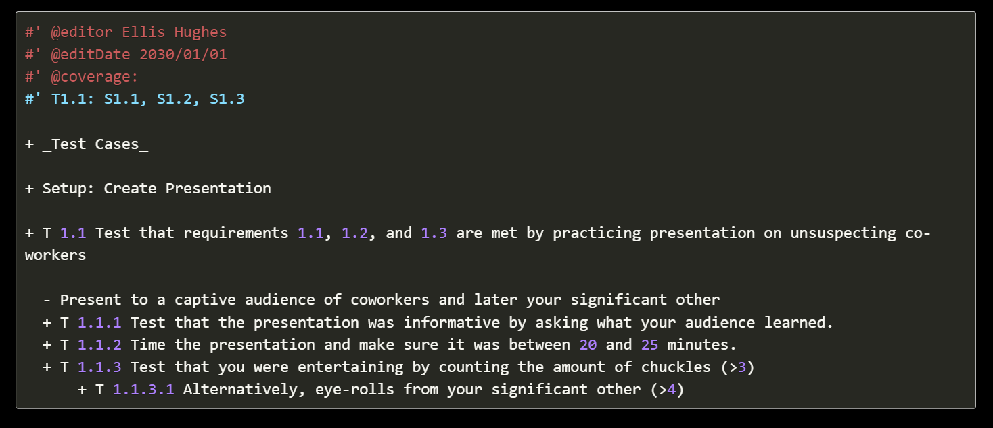

Slide 33
Validation Report
R Package Development
Test Cases
Test Code
Requirements
Record the expectations, goals, and risks of project
Implementation of requirements into R package
Describes how code meets specifications
Implementation of the test cases in code
Combines all prior content into report documenting proof that code meets specifications

Slide 34

Test Code
Implementation of test cases as code
Uses {testthat} as a familiar testing framework
Self contained
Clear expectations

Slide 35
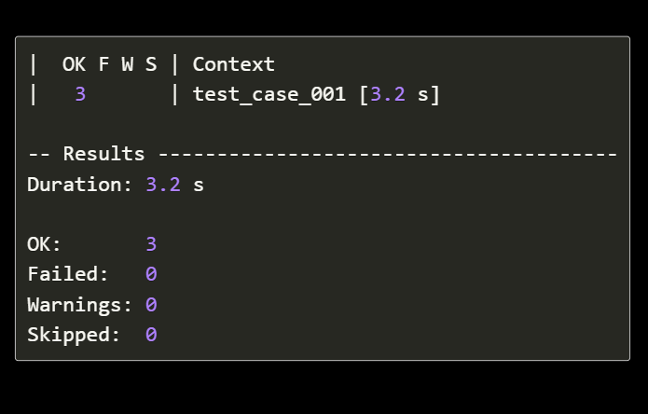
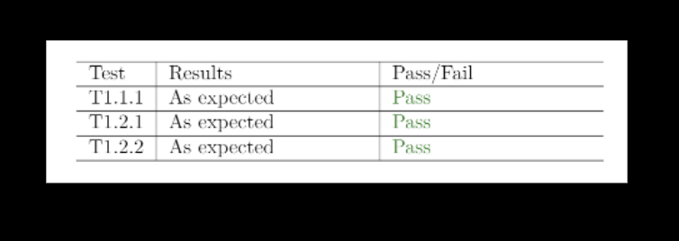
{testthat}
Reporter Object
Captures each expectation result
Records test name

Slide 36
Writing Test Code
Capture editor, edit date
Record and save within the validation folder
working_dir/validation/test_code

Slide 37
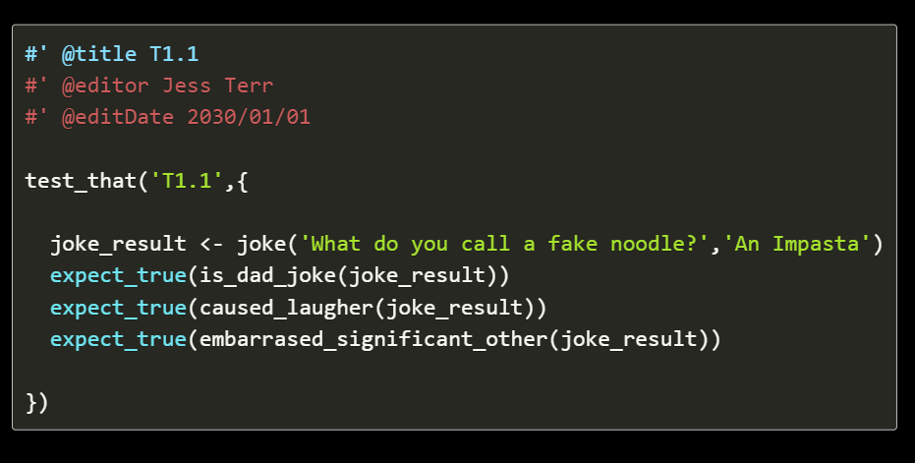

Slide 38
Validation Report
R Package Development
Test Cases
Test Code
Requirements
Record the expectations, goals, and risks of project
Implementation of requirements into R package
Describes how code meets specifications
Implementation of the test cases in code
Combines all prior content into report documenting proof that code meets specifications

Slide 39

Validation Report
Dynamically captures and records all elements generated across the framework
Records testing environment, package version
Extensible to organizations SOPs
Runs test code and captures results

Slide 40
Validation Report
Notes:
Open source tools can be extended (R packages)
- _ANYONE_ can build an R package
- change and build to address the needs of the users
- companies and teams can build packages to create a unified approach to similar problems
- benefits of R packages
Not all R packages are made equal
Maintainer
Documentation
Testing

Slide 41
Validation Report
R Package Development
Test Cases
Test Code
Requirements
Record the expectations, goals, and risks of project
Implementation of requirements into R package
Describes how code meets specifications
Implementation of the test cases in code
Combines all prior content into report documenting proof that code meets specifications

Slide 43
Validating the Package
Execute validation report on release for package build using this framework
generating a tarball people to install from, generating validation report as part of the generation
Execute validation report on installation for package build using this framework
Install from source, running the validation report
Execute validation report on update of system environment on package build using framework
Running validation report on an already installed package

Slide 44


Slide 45
Q&A
Pose questions into slack or unmute your microphone!

